Slide 1
GEDI WISE Geriatric ED Innovations in Care through Workforce, Informatics, & Structural Enhancements
Urgent Matters Conference
October 15, 2016
Lynne D. Richardson, MD, FACEP
Principal Investigator & Program Director
Professor & Vice Chair of Emergency Medicine
Professor of Population Health Science & Policy
Icahn School of Medicine at Mount Sinai
New York, New York

Slide 2
The GEDI WISE Investigators
Ula Hwang, Scott Dresden, Mark Rosenberg,
Corita Grudzen, Kevin Baumlin, Denise Nassisi,
Gallane Abraham, Jason Shapiro, Nick Genes, Maria Christensen, D.Mark Courtney, Amer Aldeen, James Adams, D. Mark Courtney, Martine Sanon, Lynne D. Richardson, (to name just a few)
This project was supported by Grant Number 1C1CMS331055-01-00 the Department of Health and Human Services, Centers for Medicare & Medicaid Services. Its contents are solely the responsibility of the authors and have not been approved by the Department of Health and Human Services,
Centers for Medicare & Medicaid Services.

Slide 3
Disclosures
Financial Disclosures / Conflicts of Interest: NONE
Current Research Funding:
NIH/National Heart, Lung & Blood Institute,
NIH/National Institute for Minority Health & Health Disparities,
NIH/National Human Genome Research Institute,
Agency for Healthcare Research and Quality
Professional Affiliations:
American College of Emergency Physicians,
Society for Academic Emergency Medicine,
American Academy of Emergency Medicine,
National Medical Association,
New York City Board of Health,
Advisory Committee to the Director of the Centers for Disease Control

Slide 4
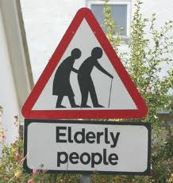

Slide 5
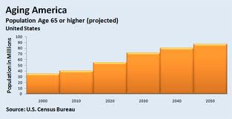
“The Silver Tsunami”
Nearly half of all adults aged 65 or older visit the ED each year

Slide 6
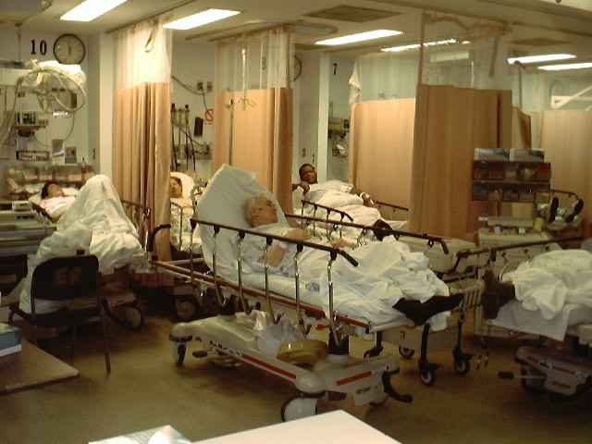
ED not well suited to Older Adults…

Slide 7
STRUCTURAL MODIFICATIONS
NEW ED PROCESSES of CARE
Notes:
Paradigm shift of ED physical design and care (Pediatric ED)
Geriatric ED Interventions (GEDIs)
Structural modifications (lighting, flooring, hearing assist devices, clocks)
Process of care modifications (screening for cognitive impairment, adverse health outcomes (e.g., ISAR, TRST, BRIGHT), nursing discharge coordinator)
Difficulty publishing in 2005-6 (published in 2007)

Slide 8
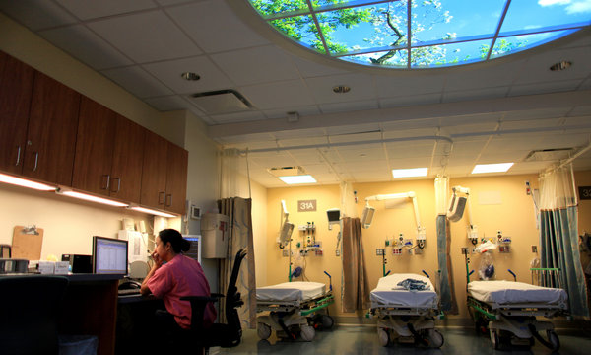
Mount Sinai Hospital Geriatric ED

Slide 9
Health Care Innovation Award
Geriatric
Emergency
Department
Innovations in care through
WWWWorkforce,
Informatics, and
Structural
Enhancements
$12.7 million
2012 – 2016
1C1CMS331055-01-00

Slide 10
GEDI WISE CMMI (Round 1) 2012 - 2016
Aim 1 (Better Health Care)
Improve the quality of geriatric emergency patient care with better:
Aim 2 (Better Health)
Aim 3 (Lower Costs)
Geriatric screenings
Pharmacist medication review
Transitions of care
Improved health status
Improved functional status
Avoid Hospitalization & Readmission
Decrease length of stay
Notes:
↓ hospital admissions
↓ 30-day subsequent admission
↓ 72H ED revisits

Slide 11
GEDI WISE Innovations
Geriatric ED with structural enhancements
Screening all ED patients 65+ for geri syndromes
Geriatric-specific care protocols
Education and training of entire ED workforce
Informatics-enhanced clinical communication and patient monitoring
Department of Emergency Medicine

Slide 12
GEDI WISE Innovations
Geriatric ED with structural enhancements
Screening all ED patients 65+ for geri syndromes
Geriatric-specific care protocols
Education and Training of entire ED workforce
Informatics-enhanced clinical communication & pt monitoring
Multidisciplinary Care Coordination in the ED
Transitional Nurse – Social Work- Pharmacist
Physical Therapist
Transitional Care Management:
ED discharge to home
7 days per week; 10 -12 hours per day
Department of Emergency Medicine

Slide 13
GW Transitional Care Innovation
Active Management of the ED-to-home transition
Nurse led
Strong social work support
Extensive medical & psychosocial assessment
Telephonic TCN follow-up post ED discharge
Health status & functional status - review of “red flag” symptoms
Medication management
Primary Care and/or Specialist Follow-Up
Department of Emergency Medicine

Slide 14
GW Transitional Care Innovation
88 year old white woman with hypertension, diabetes, arthritis and asthma presents to ED complaining of chronic R hip pain and dizziness – “almost fell” this morning.
Hospitalized a few months ago for syncope workup
Discharged home on 16 medications
Review of symptoms: ‘pan positive’
She lives alone
“… just admit her & they will sort it out upstairs”
Department of Emergency Medicine

Slide 15
GW Transitional Care Innovation
88 year old white woman with hypertension, diabetes, arthritis and asthma presents to ED complaining of chronic R hip pain and dizziness – “almost fell” this morning.
Hospitalized a few months ago for syncope workup
Discharged home on 16 medications, Review of symptoms: ‘pan positive’
She lives alone
“… just admit her & they will sort it out upstairs”
DON’T “Just Admit” – Call GEDI WISE
Department of Emergency Medicine

Slide 16
GW Transitional Care Innovation
Comprehensive assessment by the GW TCN
Pharmacy consult
Social work consult
Physical therapy consult
Discharged home with:
Simplified medication regimen and pill box
Next day Visiting Nurse home visit – for home care and home PT
Day after next appointment with her PCP
Walker, bedside commode, meals on wheels
GW TCN called her next day; day 3 and day 8
Discharged from GEDI WISE TCN with ongoing care coordination by a case manager
Department of Emergency Medicine

Slide 17
IImpact of GW Transitional Care Nurse
Decreased hospitalizations on index ED visit*
Decreased hospitalizations in next 30 days*
No increase in 72 hour ED returns*
* Adjusted for age, male sex, if index visit during evening (9p-9a) or weekend,
ESI (1-2 vs. 3-5), if patient in geriatric ED environment, if patient recently discharged
from hospital admission 30D prior, Charlson score, chief complaints
Sunday 2pm Mandalay Bay CC - Lagoon I
Plenary Abstract #4 GEDI WISE: Evaluation of Transitional Care Nurse Intervention Impact on Hospital Admissions from the ED Ula Hwang
Gratefully Acknowledge our partnership with the West Health Institute

Slide 18
Implications
Programs focused on improving care transitions for older patients appear to reduce risk of hospitalizations, both on index ED visit and the following 30 days.
ED-based transitional care programs are an effective and efficient delivery innovation to reduce likelihood of admission, subsequent complications associated with hospitalization, and potential costs of inpatient care.
Who is going to pay for these ED-based resources?
Department of Emergency Medicine

Slide 19
Funding ED-based Transitional Care
Hospital
To avoid readmission penalties
To succeed in risk–based contracts with insurers or employers
Accountable Care Organizations
Performing Providers Systems
Insurers
Department of Emergency Medicine

Slide 20
Funding ED-based Transitional Care
GEDI WISE has been succeeded by TRACED
TRAnsitions in Care from the Emergency Department
Sustains all of the GW clinical resources
Expands them to patients < 65 years old
Identifies additional vulnerable population groups
Department of Emergency Medicine

Slide 21
Thank you for your attention!
Lynne.Richardson@mssm.edu
?’s

